Slide 1
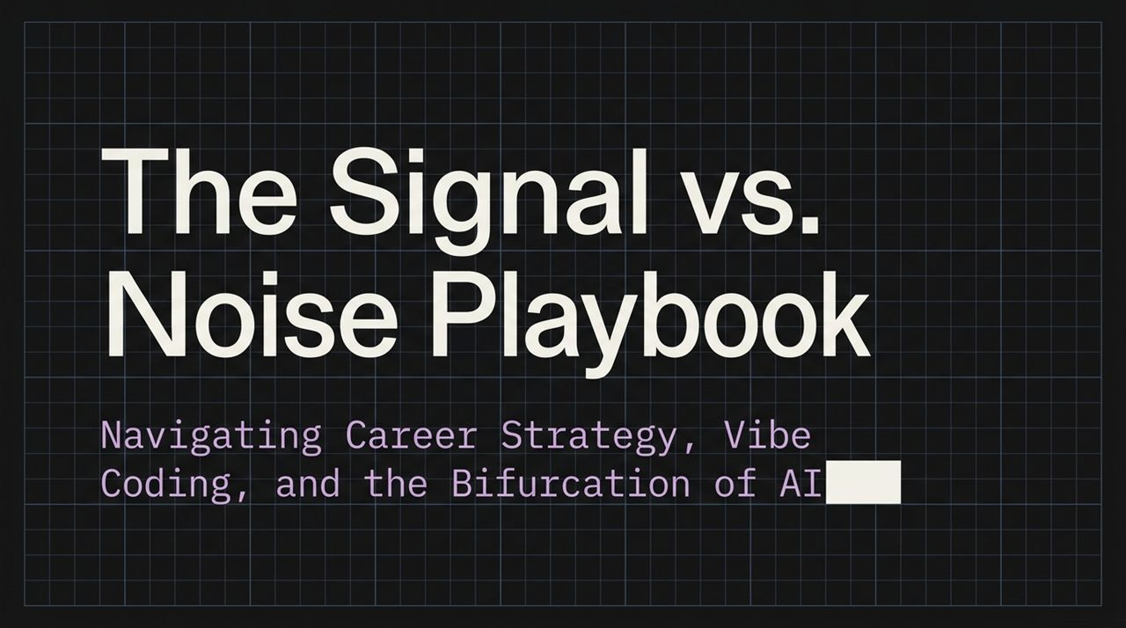
Notes:
Opening Hook: Welcome, everyone. Today we’re going to discuss how to navigate career strategy, vibe coding, and the massive structural bifurcation taking place in AI.
The Core Thesis: We live in an era where AI is moving so fast that distinguishing true signal (actionable, high-impact strategies) from noise (social media hype, short-term trends) is the single most critical superpower for tech leaders and engineers.
Overview of Today's Agenda: Over the next hour, we’re going to cover:
How AI coding capability is shifting product development bottlenecks.
How to shift your focus from writing syntax to product specification and customer empathy.
The three pillars of the AI-era builder and how to avoid the "Overhiring Hangover."
Navigating technical debt in an era of AI code generation (Vibe Coding).
The bifurcation of AI: Cloud-hosted Big AI vs. Self-hosted/Open-weights Small AI.
Takeaway: By the end of this talk, you will have a concrete framework to evaluate where to spend your engineering time, how to build career defensibility, and how to drive real bottom-line value.
https://www.youtube.com/watch?v=AVvDFsMUxf0

Slide 2
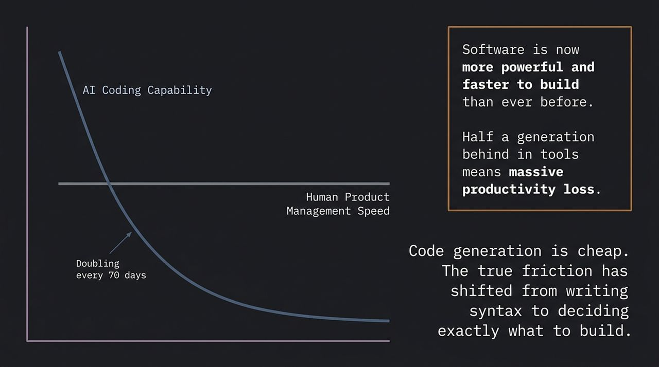
Notes:
The Exponential Curve: Look at the chart on this slide. Research tracking AI capabilities shows that the complexity of coding tasks AI can execute is doubling approximately every 70 days.
Tooling Velocity: In practical terms, this means the tools available today—whether it's Claude Code, OpenAI Codex, or Gemini—are dramatically outperforming what was available just six months ago. Staying half a generation behind on your tooling stack translates directly into a massive productivity loss.
The Fundamental Shift: Because software is now vastly cheaper and faster to generate, code itself is no longer the bottleneck. Writing raw syntax is becoming a commodity.
The New Bottleneck: The true friction in building modern software has shifted from how to code it to deciding exactly what to build.
Transition to Next Slide: This change fundamentally rewrites the traditional roles within software engineering and product management.

Slide 3
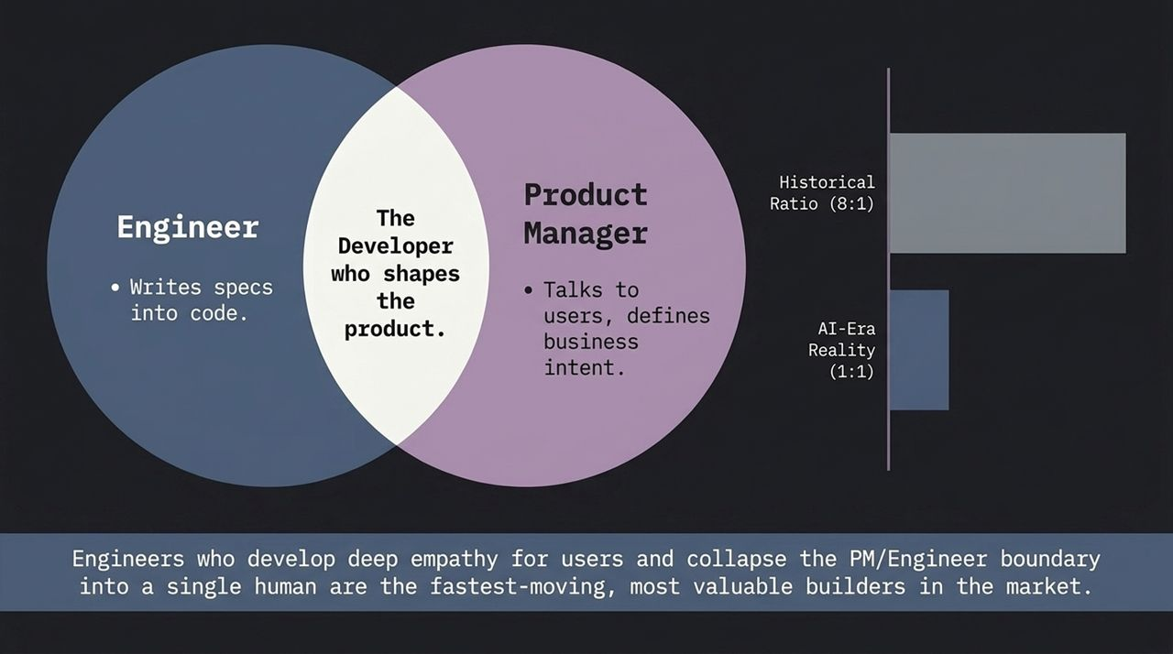
Notes:
Historical vs. AI-Era Ratios: Historically, tech companies operated at an 8:1 (or 5:1) Engineer-to-Product Manager ratio. You had eight engineers translating specs written by a PM into code.
The New Reality (1:1 Ratio): In the AI era, that ratio is collapsing toward 1:1 or 2:1. Why? Because AI can handle the syntax generation, allowing individual developers to quickly prototype and iterate.
Collapsing the Boundary: The most valuable builders in today's market are engineers who develop deep customer empathy and collapse the traditional boundary between Product Manager and Engineer into a single workflow.
Execution Velocity: When an engineer can talk directly to users, understand business intent, and immediately translate that intent into working code without waiting for handoffs or long spec documents, execution velocity skyrockets.
Key Takeaway: Don't just sit back and wait for specs. Develop product intuition, speak to users, and leverage AI to build fast end-to-end solutions.

Slide 4
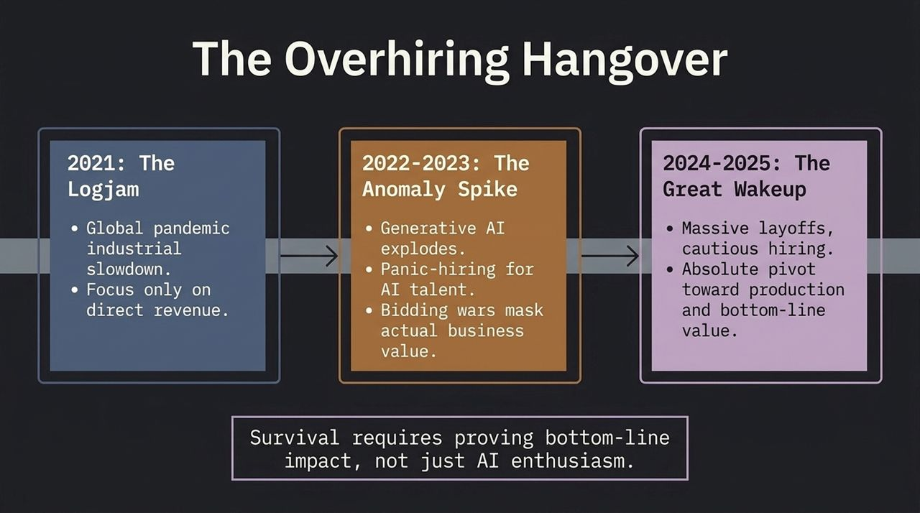
Notes:
Contextualizing Market Trends: To understand where career opportunities lie today, we have to look back at how we got here over the last five years.
2021 (The Logjam): During the global pandemic industrial slowdown, tech companies focused tightly on direct revenue and immediate operational survival.
2022–2023 (The Anomaly Spike): Generative AI exploded into public consciousness. Panic-hiring set in across Silicon Valley and major tech hubs. Bidding wars for any AI talent created inflated compensation packages that often masked whether actual business value was being delivered.
2024–2025 (The Great Wakeup): Now we are in the aftermath. We've seen massive industry layoffs, cautious hiring loops, and a strict pivot toward bottom-line profitability and production readiness.
Career Implication: Pure AI enthusiasm is no longer enough to land or keep top roles. Survival and advancement in the current market require proving tangible, bottom-line business impact.

Slide 5
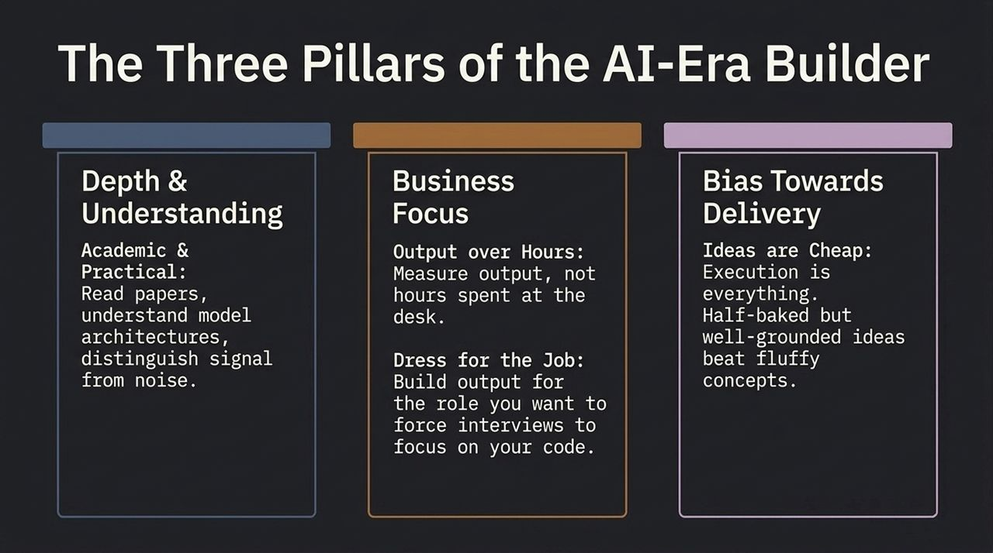
Notes:
Framework Introduction: How do you position yourself as an indispensable builder in this new market? We break it down into three core pillars:
1. Depth & Understanding:
Combine academic rigor with practical execution.
Read research papers, understand underlying model architectures, and learn how to distinguish real technical breakthroughs from media hype.
2. Business Focus:
Output over Hours: Measure yourself—and your team—by tangible business output rather than desk hours.
Dress for the Job You Want: Build public projects and output tailored to the exact role you are targeting, forcing interview loops to focus on your actual working code rather than abstract puzzles.
3. Bias Towards Delivery:
Ideas are cheap; execution is everything.
A half-baked, well-grounded proof of concept running in production will always beat a polished, fluffy concept deck.

Slide 6
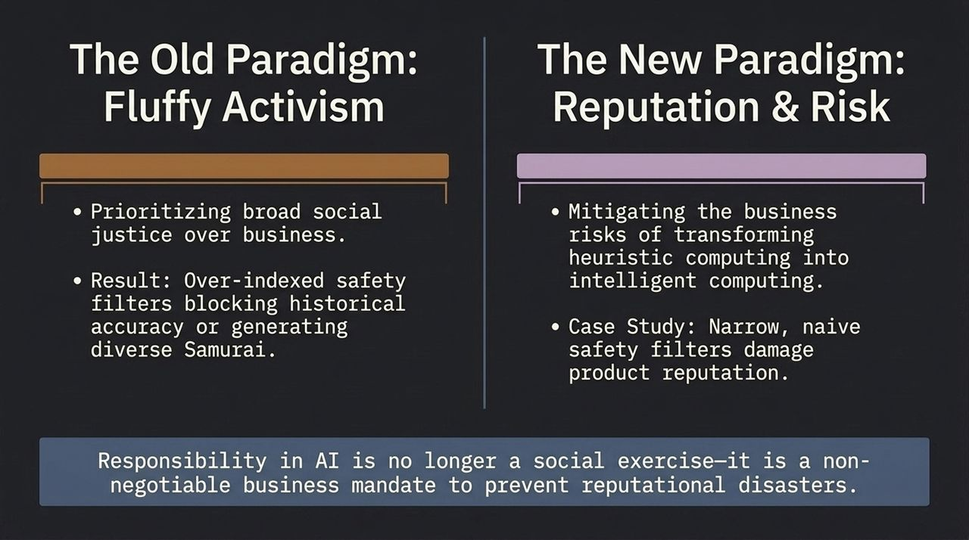
Notes:
The Old Paradigm: In previous years, corporate AI initiatives often drifted into broad social activism or superficial PR exercises, sometimes resulting in heavy-handed, naive safety filters that damaged historical accuracy or user experience.
The New Paradigm (Reputation & Risk): Today, AI ethics and governance have shifted into a core risk-management discipline.
Business Mandate: Transforming software from deterministic/heuristic computing to probabilistic AI introduces massive operational and reputational risks.
Case Study Lesson: When AI products generate wildly inaccurate or hallucinated results due to poorly implemented safety wrappers, it directly erodes customer trust and product reputation.
Takeaway: Responsibility in AI is no longer an abstract exercise—it is a non-negotiable business mandate to safeguard product integrity and brand equity.

Slide 7
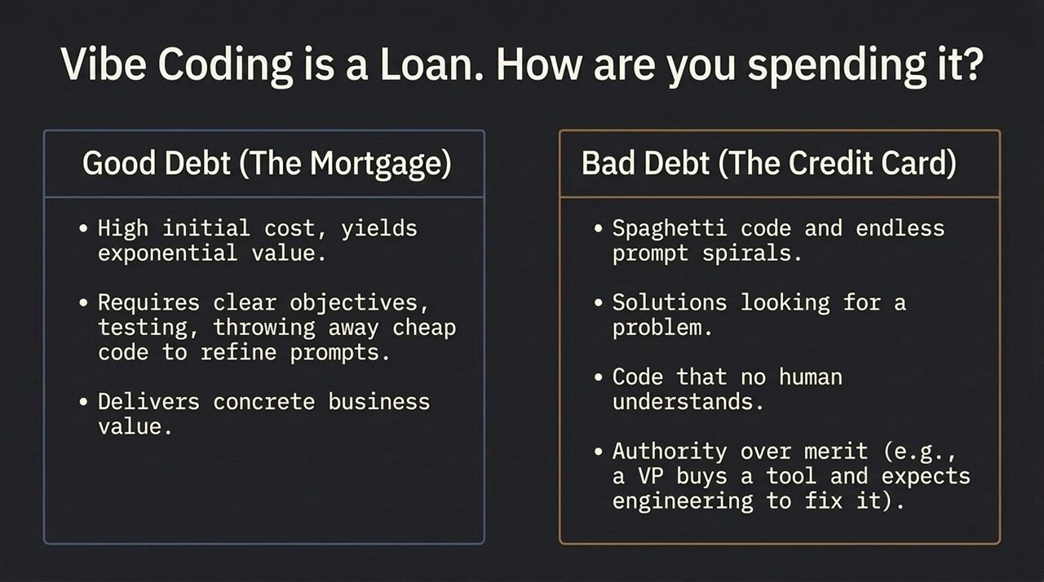
Notes:
Reframing "Vibe Coding": Using AI to instantly generate hundreds of lines of code—often called "Vibe Coding"—is essentially taking out financial leverage. You are borrowing speed today, but how are you going to service that debt tomorrow?
Good Debt (The Mortgage):
High upfront investment in structuring prompts, testing, and being willing to throw away cheap code to refine the core logic.
Delivers concrete business value, maintains clear architectural boundaries, and includes rigorous test coverage.
Bad Debt (The Credit Card):
Accumulating unreadable spaghetti code and getting stuck in endless trial-and-error prompt loops.
Building flashy solutions in search of a problem.
Pushing code to production that no human on the team truly understands.
Top-down mandates: Instances where executives force teams to adopt AI tools blindly without engineering oversight.
Takeaway: Use AI code generation strategically, but ensure your team retains deep comprehension of the underlying codebase.

Slide 8
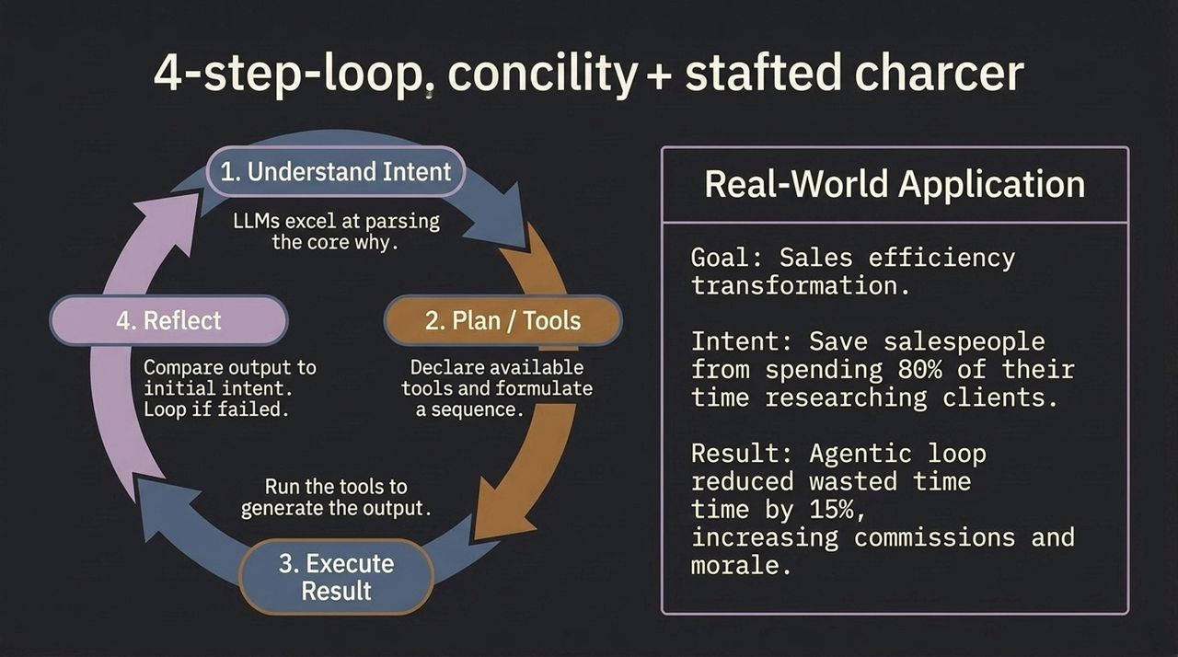
Notes:
The 4-Step Loop: To manage agentic workflows effectively, structure your applications around four key stages:
Understand Intent: Large Language Models excel at parsing human goal intent (the "why").
Plan & Select Tools: Declare available APIs/tools and map out a execution sequence.
Execute: Run the tools to generate the desired output.
Reflect: Compare the result against the initial intent; if it fails, loop back and self-correct.
Real-World Case Study (Sales Efficiency):
Problem: Enterprise salespeople were spending 80% of their time manually researching prospective clients rather than selling.
Solution: Built an agentic loop designed specifically around client research and intent-matching.
Outcome: Reduced wasted administrative time by 15%, directly boosting sales commissions, revenue, and team morale.

Slide 9
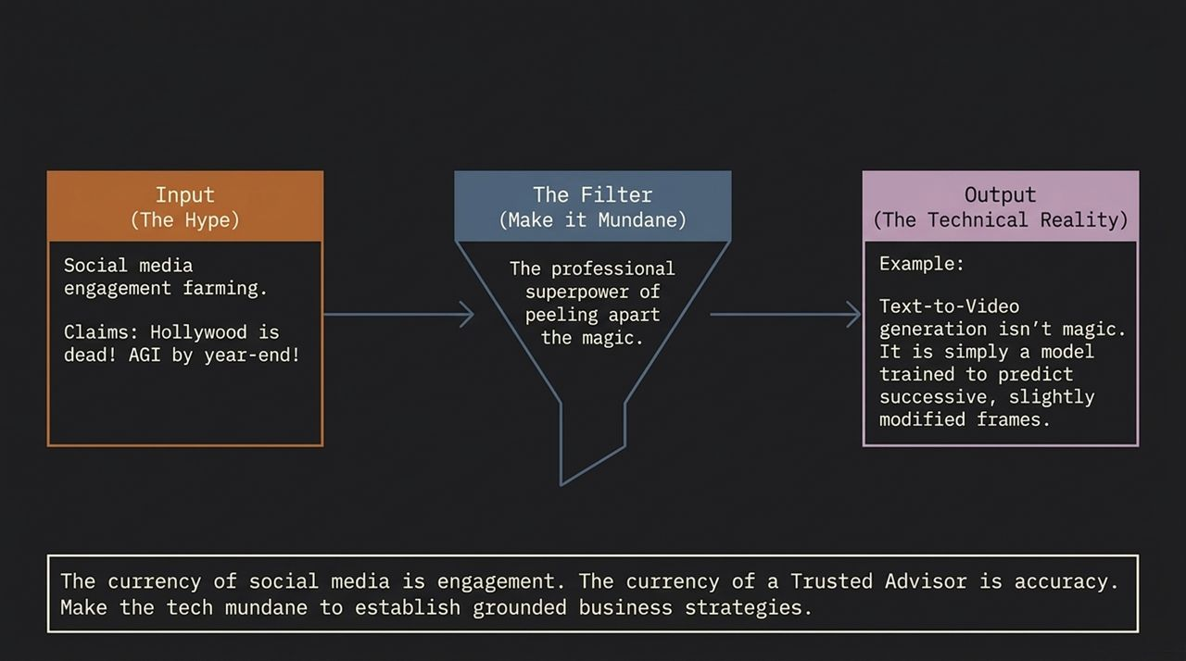
Notes:
The Hype Machine: Social media and tech influencer channels run on engagement farming—promising things like "Hollywood is dead next month!" or "AGI by the end of the year!"
The Professional Superpower: The hallmark of a true technical leader is the ability to peel away the "magic" and make the underlying technology mundane.
Example (Text-to-Video): Text-to-video isn't magic or black box wizardry—it is fundamentally a diffusion model trained to predict successive, slightly modified frame tensors.
Currency Distinction:
The currency of social media is clicks and engagement.
The currency of a Trusted AI Advisor is accuracy and pragmatic execution.
Takeaway: Demystify the technology for your stakeholders so you can build grounded, achievable business strategies.

Slide 10
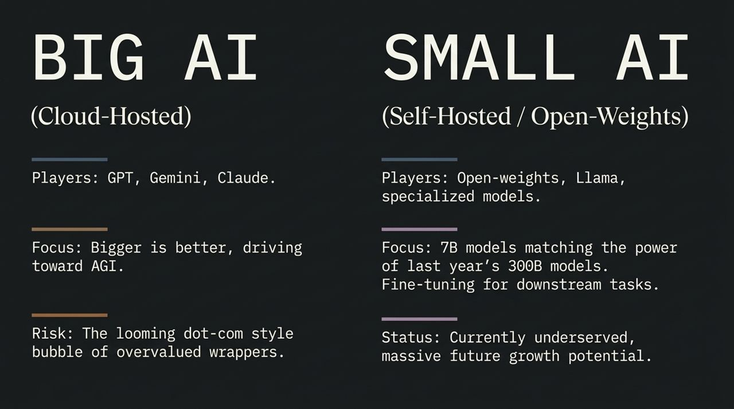
Notes:
Industry Bifurcation: The AI landscape is dividing into two distinct paradigms:
Big AI (Cloud-Hosted Frontier Models):
Players: OpenAI (GPT), Google (Gemini), Anthropic (Claude).
Focus: Scale-at-all-costs, massive compute clusters, pursuing general intelligence (AGI).
Risk: Exposure to high API costs, latency, and a looming dot-com style valuation bubble around thin UI wrappers.
Small AI (Self-Hosted / Open-Weights):
Players: Llama, Mistral, open-weights ecosystem, domain-specialized models.
Focus: Rapid efficiency gains—modern 7B parameter models frequently match or exceed the capability of older 300B models on specific downstream tasks.
Status: Currently under-indexed in mainstream media, but represents massive commercial growth potential.

Slide 11
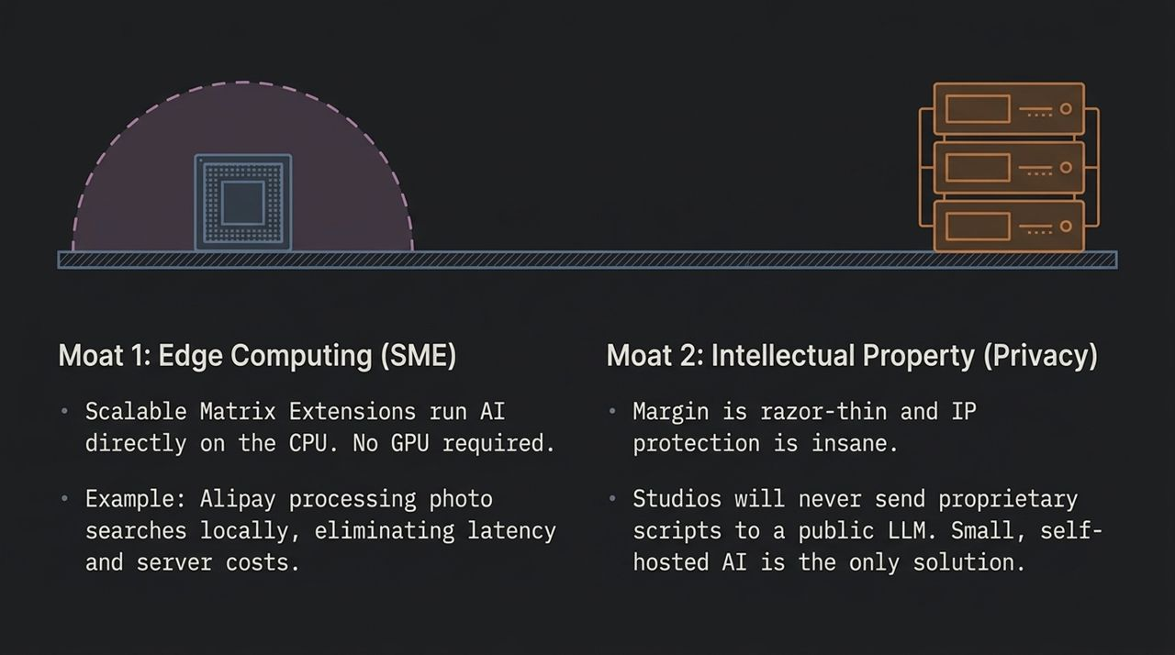
Notes:
Moat 1: Edge Computing & Hardware Acceleration:
Features like Scalable Matrix Extensions (SME) allow specialized models to run directly on standard CPUs without requiring expensive GPU infrastructure.
Example: Alipay processing local photo search queries directly on user hardware, completely eliminating external server costs and round-trip network latency.
Moat 2: Intellectual Property & Data Privacy:
In industries like media, healthcare, finance, and enterprise software, margins are tight and IP protection is critical.
Major movie studios or defense contractors will never send proprietary scripts or sensitive internal data to a public cloud API.
Self-hosted, fine-tuned, open-weights models are often the only viable path for privacy-sensitive enterprise environments.

Slide 12
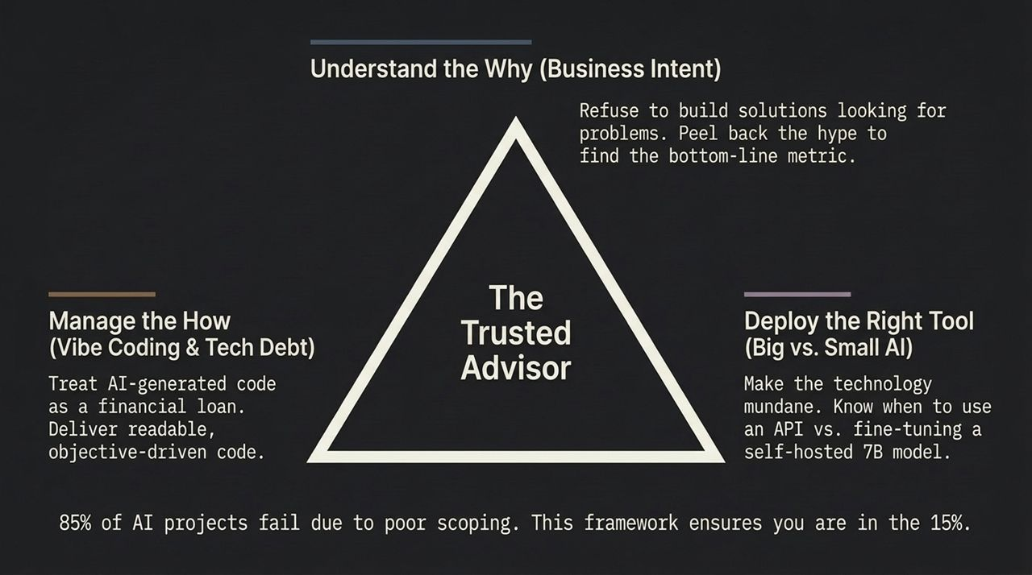
Notes:
Why AI Projects Fail: Industry data shows that up to 85% of corporate AI projects fail, primarily due to poor scoping and chasing shiny objects.
The 3-Part Framework to Join the 15%:
Understand the WHY (Business Intent): Refuse to build tech solutions in search of problems. Always trace the project back to a core bottom-line metric.
Manage the HOW (Vibe Coding & Tech Debt): Treat AI code generation like financial leverage. Ensure code remains maintainable, readable, and architecturally sound.
Deploy the RIGHT Tool (Big vs. Small AI): Strip away the hype. Know precisely when to call a frontier cloud API vs. fine-tuning an on-premise 7B open-weights model.

Slide 13
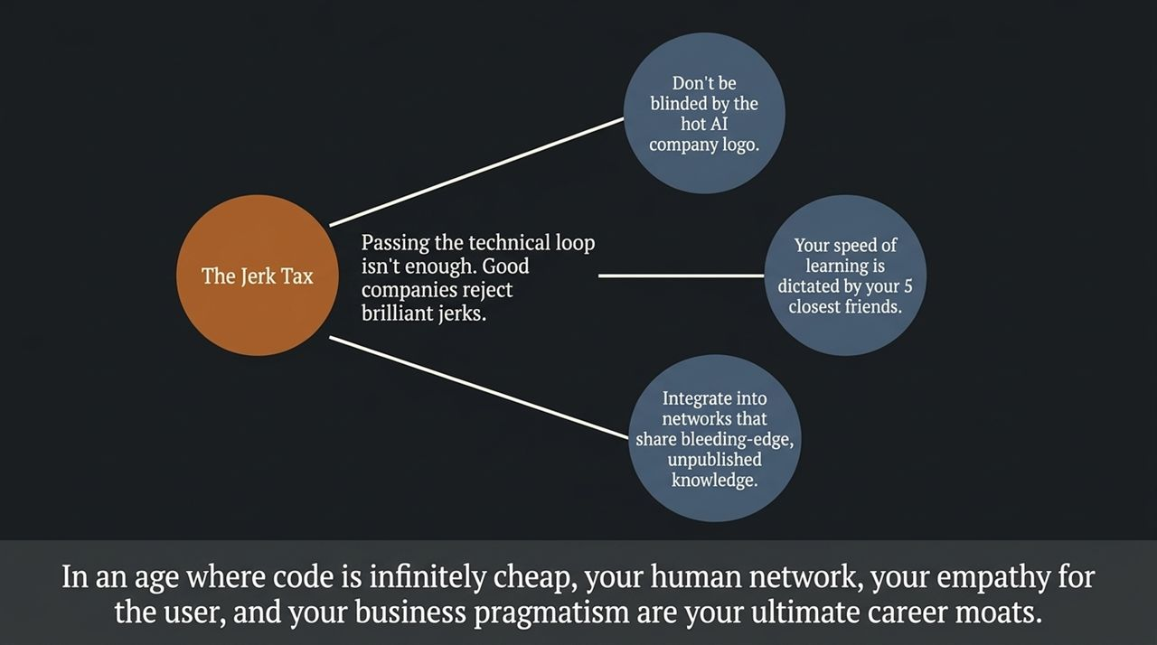
Notes:
The Jerk Tax: Passing technical coding loops is no longer a sufficient moat when AI can pass technical loops, too. Great engineering organizations actively reject "brilliant jerks" who destroy team cohesion.
Avoid Brand Blindness: Don't evaluate your career trajectory solely by a flashy company logo. Evaluate it by the quality and integrity of the team you'll work with daily.
The Network Effect: Your speed of learning and professional growth is largely dictated by the five closest colleagues in your immediate circle.
Bleeding-Edge Networks: Position yourself in peer networks that share practical, unpublished, bleeding-edge insights rather than regurgitated social media noise.
Core Takeaway: When code generation is cheap, your human network, user empathy, and business pragmatism are your ultimate career moats.

Slide 14
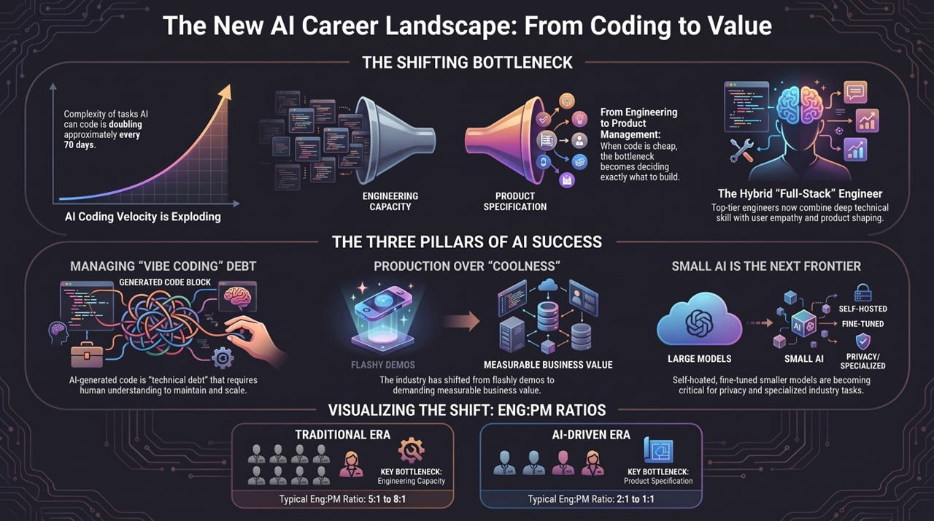
Notes:
Synthesizing the Deck: Let's bring everything together in this visual summary:
The Shifting Bottleneck: Coding complexity doubles every 70 days. Engineering capacity is expanding rapidly, making product specification the primary constraint.
The Hybrid Engineer: Success requires combining technical proficiency with product intuition.
Managing Debt: Vibe coding creates technical debt that requires human oversight to maintain.
Shift to Value: Move away from flashy demos toward measurable business outcomes.
Small AI Frontier: Self-hosted, fine-tuned models are becoming essential for privacy and domain specificity.
Eng:PM Ratios: Traditional 8:1 ratios are collapsing to 1:1, empowering developers to own the full product lifecycle.
Closing Remark: Focus on signal over noise, build for business value, and leverage AI to amplify your human strengths.

